Slide 1
Agenda
Services in the EC2 (Elastic Compute Cloud)
Instance types
AMI – Amazon Machine Image
EBS – Elastic Block Storage
EIP – Elastic Internet protocol
Volumes – EBS Storage
Snapshots – For instance backup
Network interface – instance communication
Bootstrap – Pre-configuration process for EC2 instances

Slide 2
8-Instance Types

Slide 3
Amazon EC2 Instance Types
Amazon EC2 provides a wide selection of instance types optimized to fit different use cases.
Instance types comprise varying combinations of CPU, memory, storage, and networking capacity and give you the flexibility to choose the appropriate mix of resources for your applications.
Each instance type includes one or more instance sizes, allowing you to scale your resources to the requirements of your target workload.

Slide 4
Amazon EC2 Instance Types
We have few types of the instances available, those categorized in to the following.
General Purpose
Compute Optimized
Memory Optimized
Accelerated Computing
Storage Optimized
You can check the full list of the instance types from the below URL
Reference link: https://aws.amazon.com/ec2/instance-types/

Slide 5
Change Instance Type
We can change instance types from one type to another with few clicks, but there is down time involved here because we must shut down the instance to change instance type.
To change the instance type, select your instance and go to actions then instance state then stop.

Slide 6
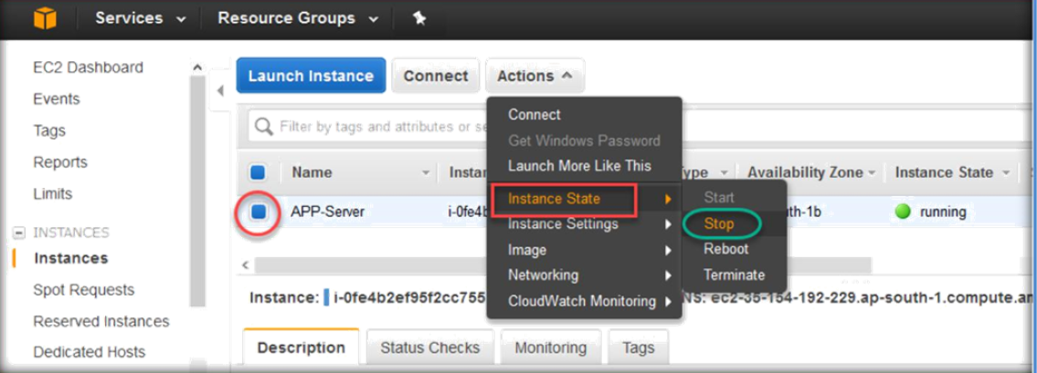
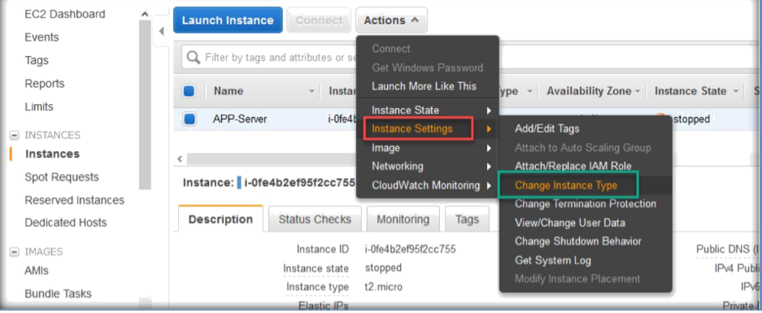
Once the instance has stopped, make sure you select the instance and go to Actions tab, expand Instance Settings, then choose Change Instance Type.

Slide 7
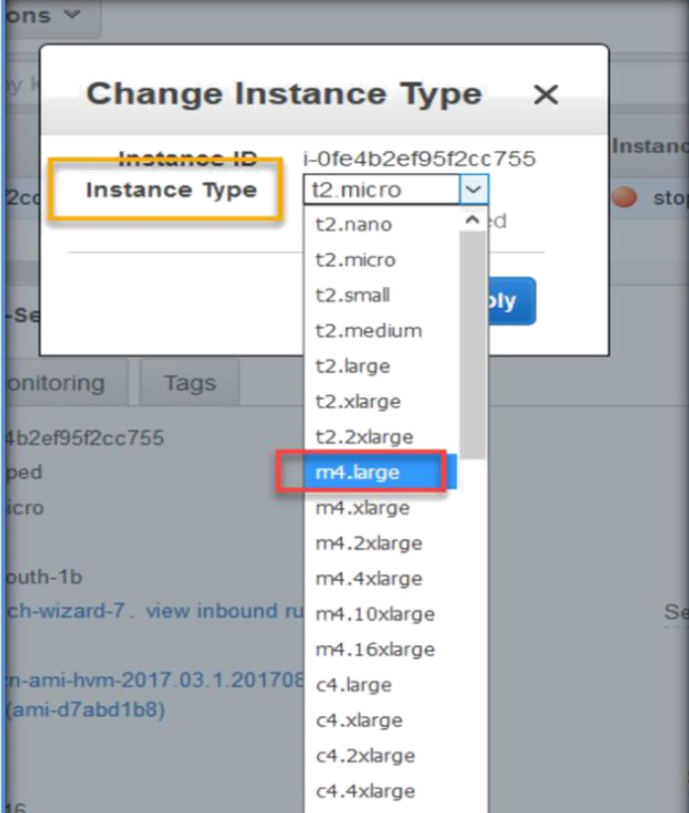
Next, Change instance type wizard will open, choose the new instance type from instance type drop down list.
Next, clck on apply.

Slide 8
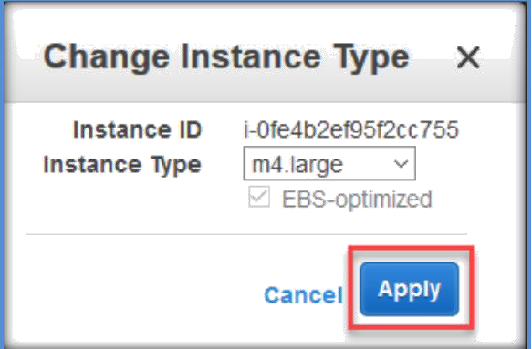
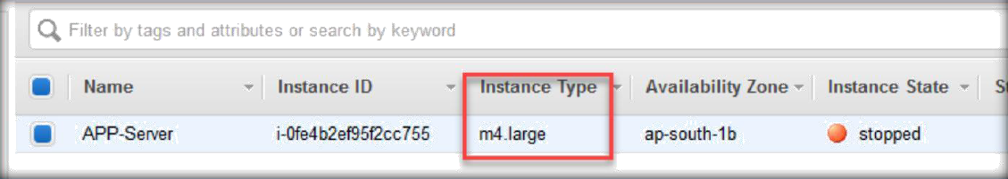
Now, you can able to see the new instance for the instance under the instance type tab.
Now you can start the instance and it will start with the new m4.large CPU and RAM configuration.

Slide 9
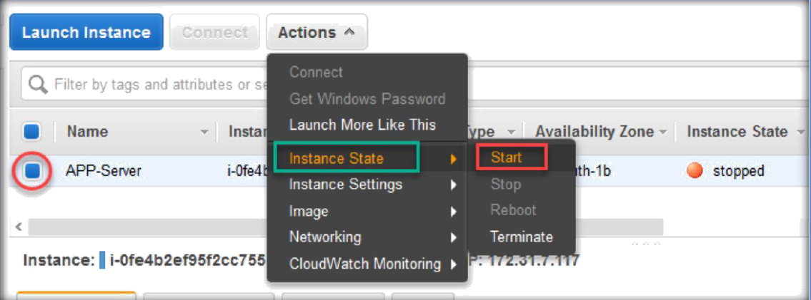

Slide 10
